Slide 1
Project Presentation
Team 17: Xiying Zhao, Crystal Wang, Jiyuan Feng

Slide 2
CONTENTS
01
02
03
04
Project 1
Project 2
Project 3
Conclusion

Slide 3
Project 1
Queries on the yelp data to help start a new restaurant.

Slide 4

Project 1
Enter the gourmet industry—
What to pay attention to start a restaurant?
Location
type
name
Opening time

Slide 5
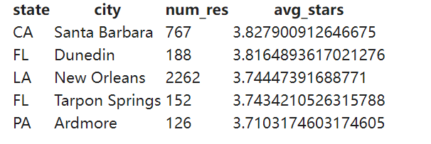
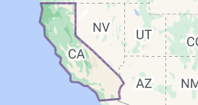
1.1—City to start our new restaurant
Santa Barbara has the second highest number of restaurants with the highest average stars which means Diners here are keen to eat out, and the local food atmosphere is strong.

Slide 6
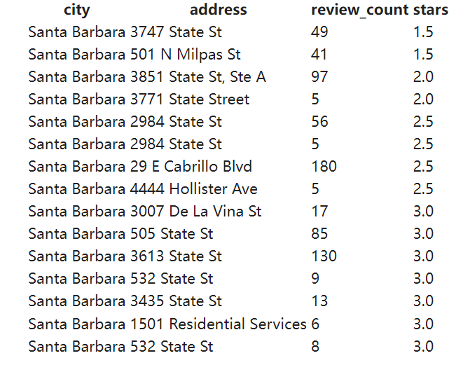
1.2—Location without much competition
The top 2 addresses have lowest stars so we guess people there are eager to delicious food and we have much more opportunities there!

Slide 7
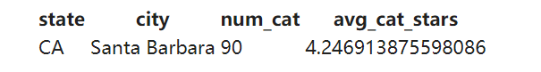
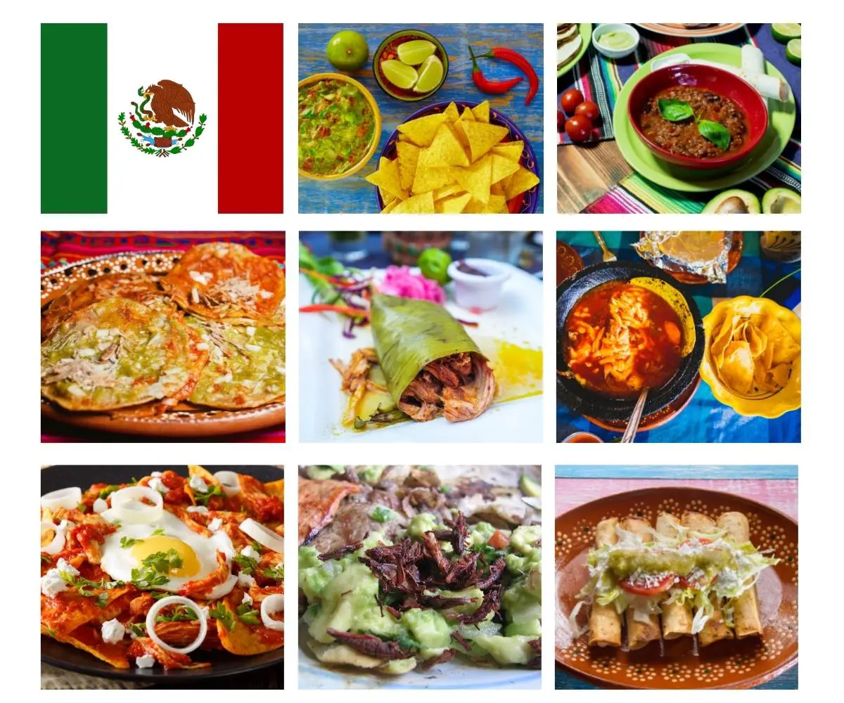
1.3—Secret Skellies Society total sales and volume
In Santa Barbara CA, People rated four stars for Mexican Food and there are many Mexican restaurants proving we all love it!

Slide 8
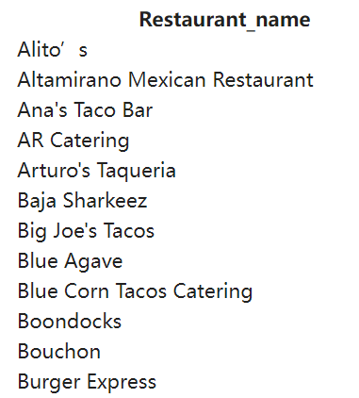
1.4—name our restaurant
A nice and unrepeated name is also the key to attracting customers

Slide 9
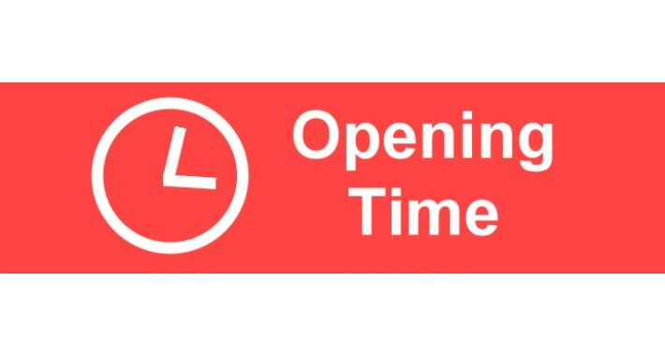
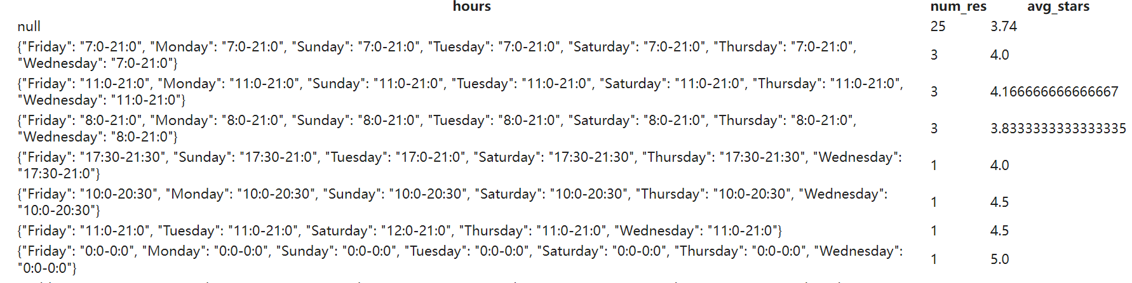
1.5—Decide on the opening period
Sometimes customers give bad reviews because the restaurant is not open when they want to eat.

Slide 10

Key skills
·Read and Interpret JSON Data
·Convert JSON to MySQL
·Update MySQL tables by accessing API's

Slide 11

Project 2
Secret Skellies Society
(NEAR)
Notes:
https://app.flipsidecrypto.com/dashboard/team-17-miniproject-2-fidenza-analysis-IUTFYP;
https://app.flipsidecrypto.com/dashboard/team-17-miniproject-2-secret-skellies-society-analysis-NwOGXM;

Slide 12

Project 2
Secret Skellies Society minted in Jan 2022. By April 2022, it became the 8th most traded NFT.
We are very interested in this new NFT and did a series of analysis.
Sales
New User
Failed Rate
Sales count
Sales volume
Number of users
Traded fail rate

Slide 13
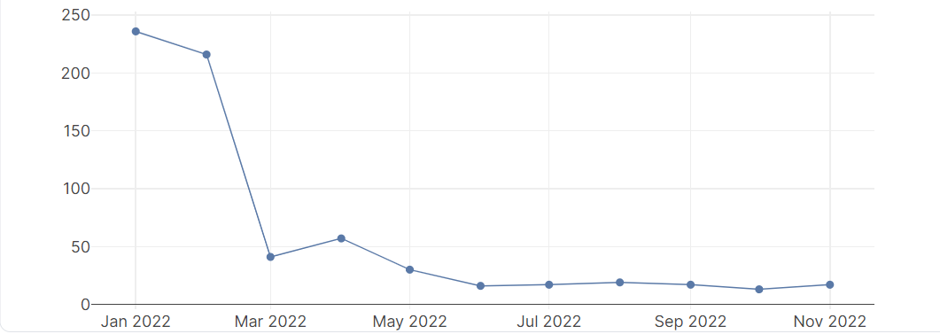
2.1 Secret Skellies Society sales count in 2022
Since minted, the number of sales decreased and gradually stabilize over time.

Slide 14
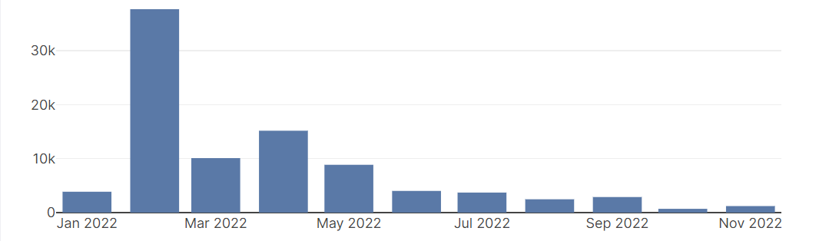
2.2. Secret Skellies Society sales volume in 2022
High sale count in Jan 2022 but low sales volume. Highest sales

Slide 15

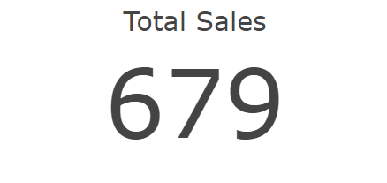
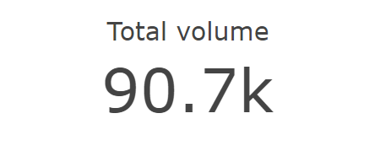
2.3. Secret Skellies Society total sales and volume

Slide 16
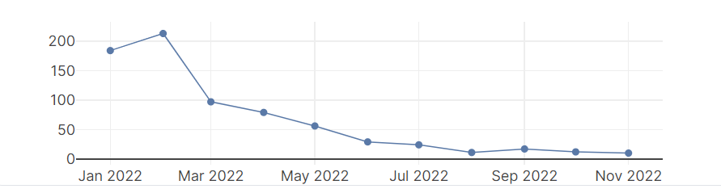
2.4. Secret Skellies Society new users per month
Increased first two months then decrease.

Slide 17

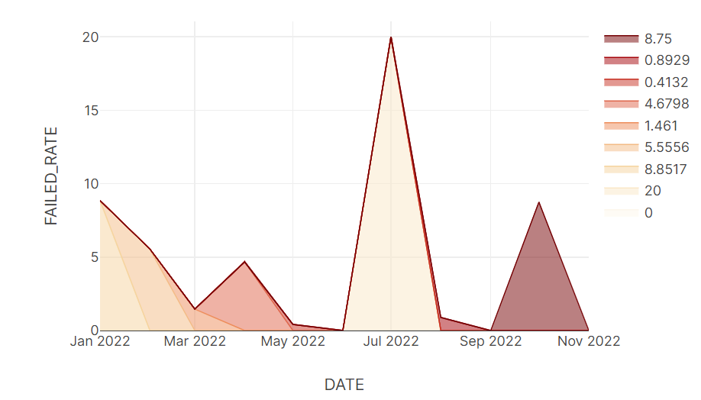
2.5. Secret Skellies Society failed rate

Slide 18
Key concepts
Deeper understand of how blockchain (NFT) works in a business view
Learned to use Flipside to analyze blockchain

Slide 19
Project 3
Using Knime to solve two business problems.

Slide 20
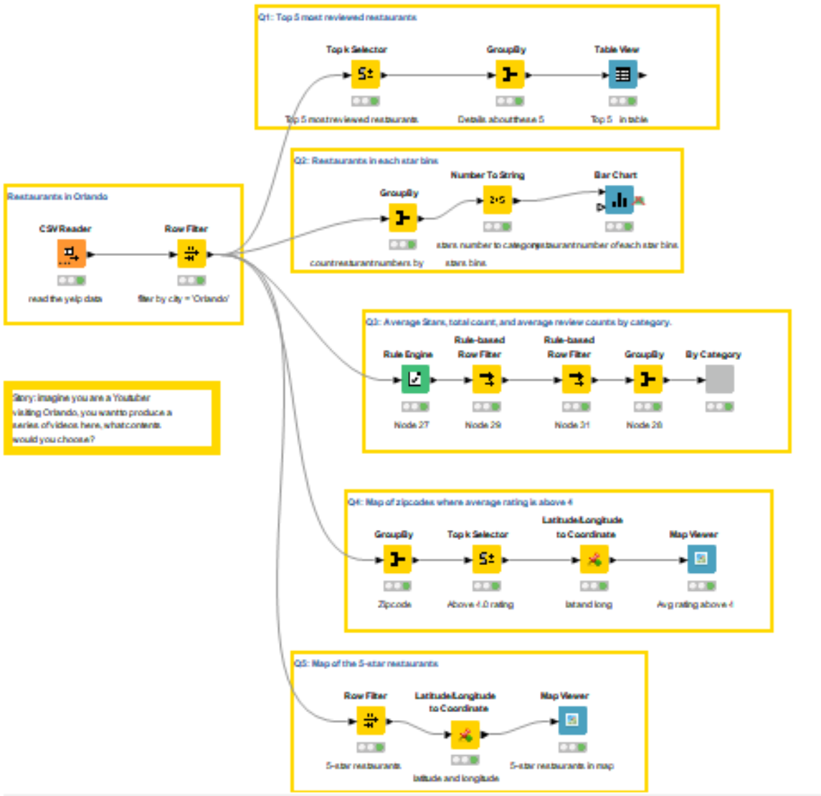
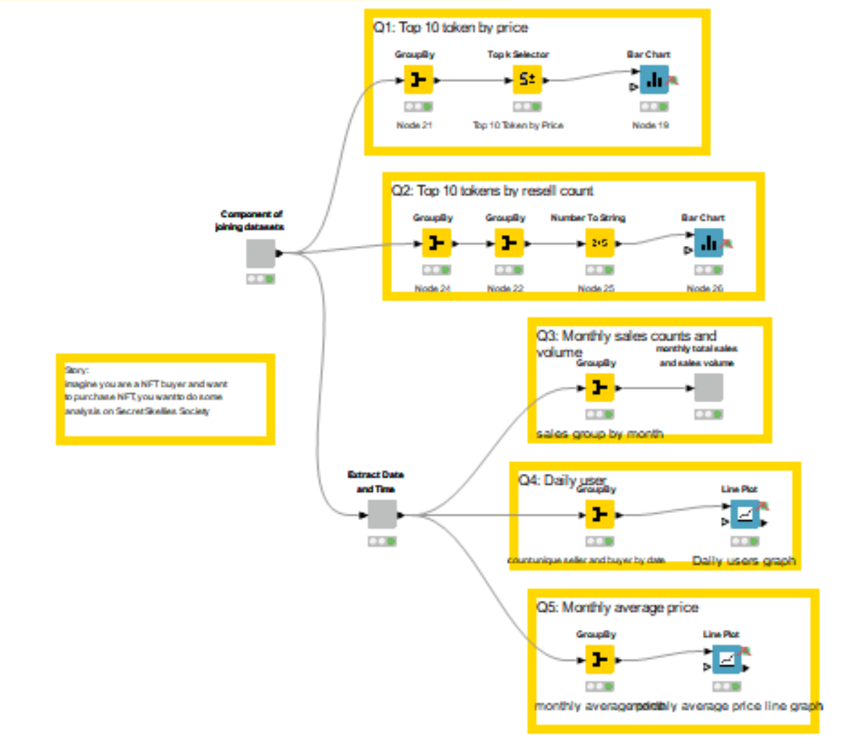
Workflows

Slide 21
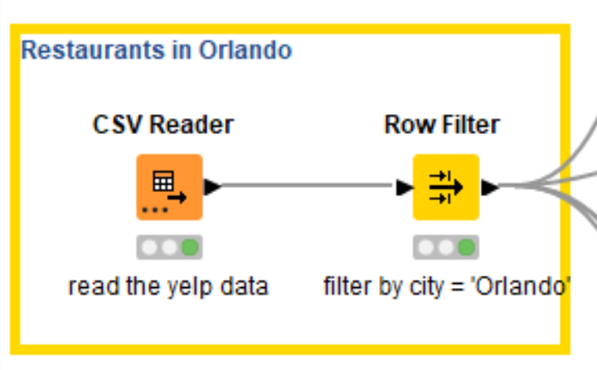
3.1 yelp - restaurants in Orlando
We want to invite youtube influencers to produce a series of videos about eating in Orlando, what contents could we choose?
1. Top 5 most reviewed restaurants.
2. Restaurants number and average reviews of each star bins.
3. Most popular type (based on average stars and reviews)
4. Restaurants zipcodes where average rating is above 4
5.5-star restaurants in map.

Slide 22
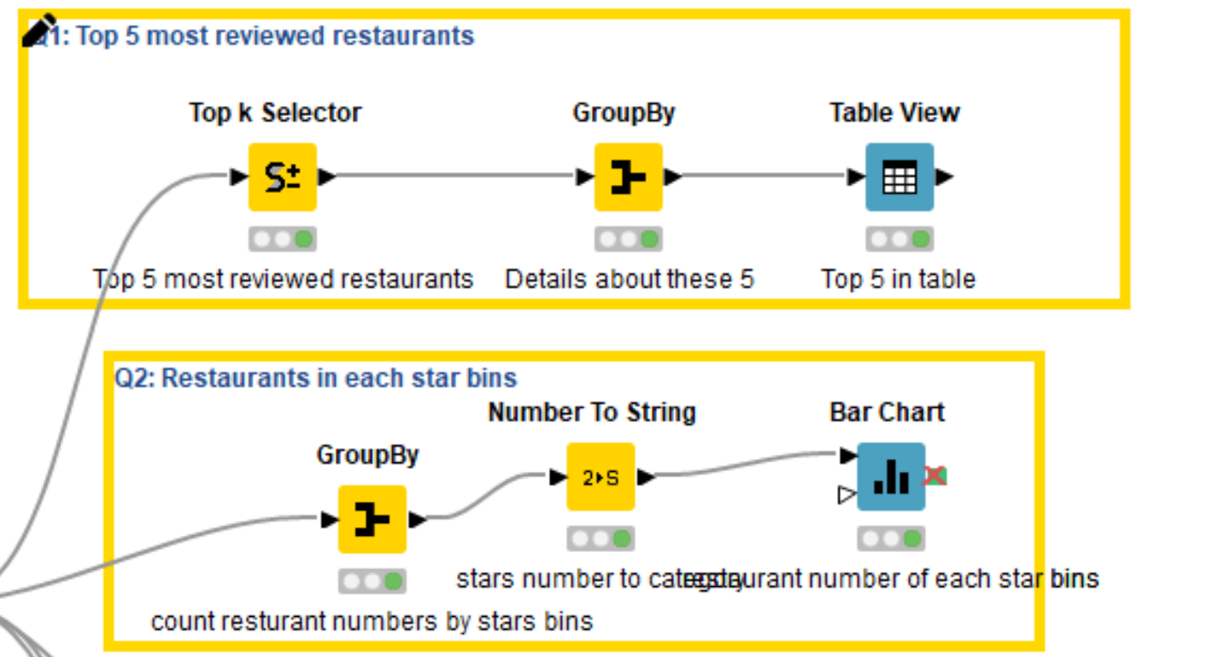
3.1.1 Top 5 most reviewed restaurants

Slide 23
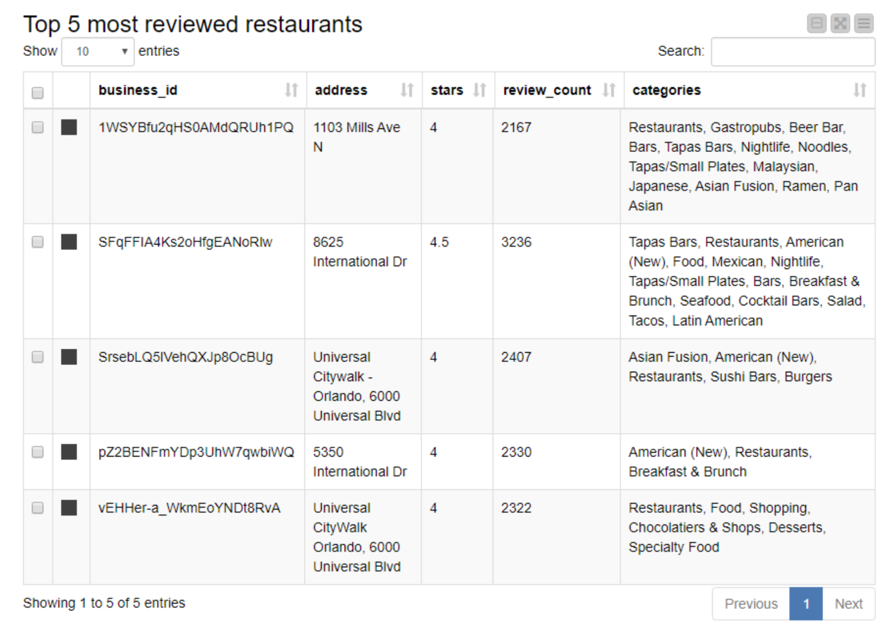
3.1.1 Top 5 most reviewed restaurants

Slide 24
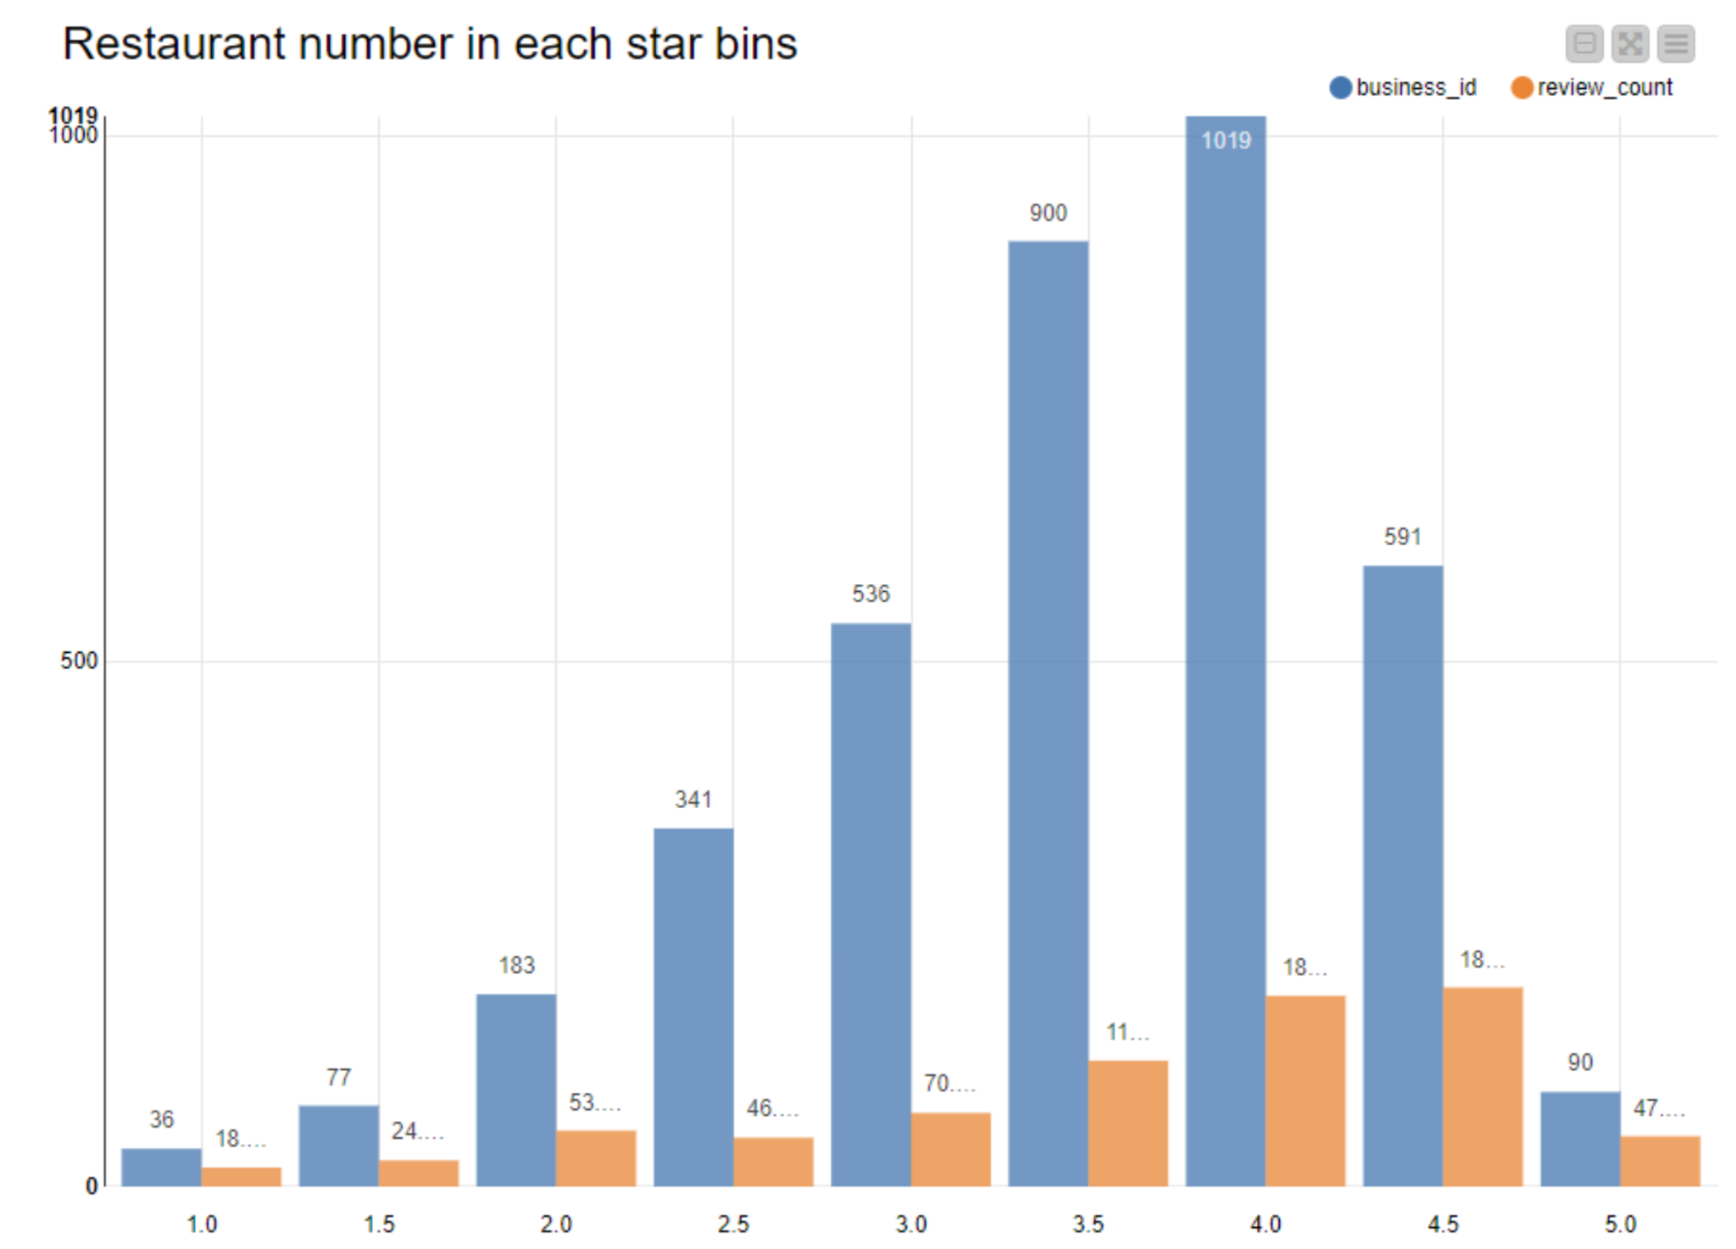
3.1.2 Restaurants number and average reviews of each star bins.
Most are scored 4 stars.
4-star and 4.5 star restaurants have most average reviews.

Slide 25
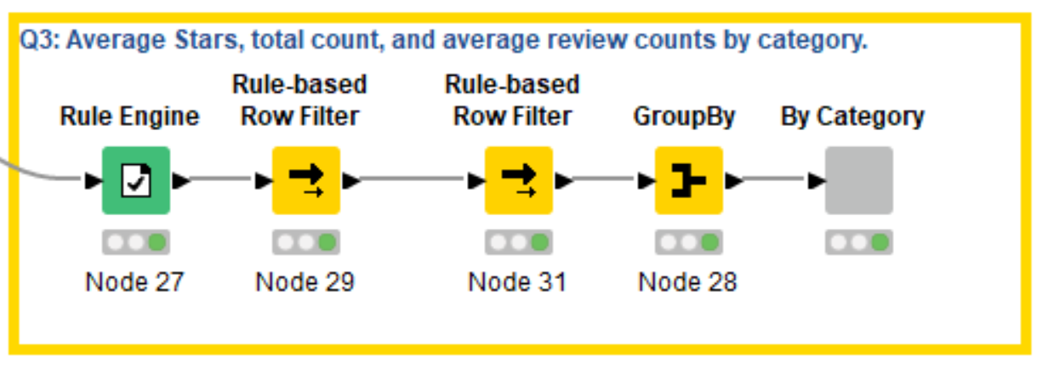
3.1.3 Most popular type (based on average stars and reviews)

Slide 26
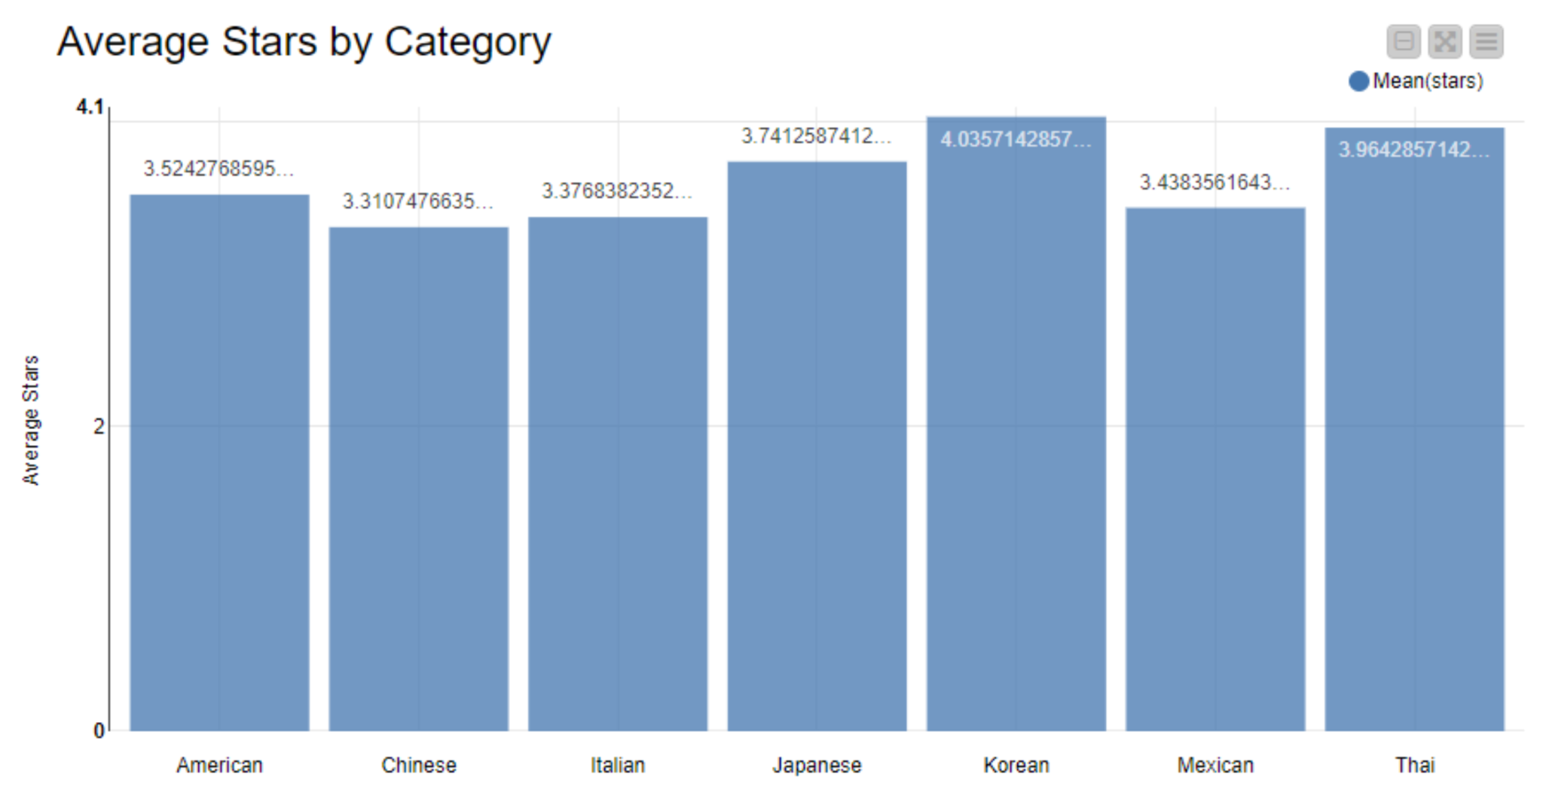
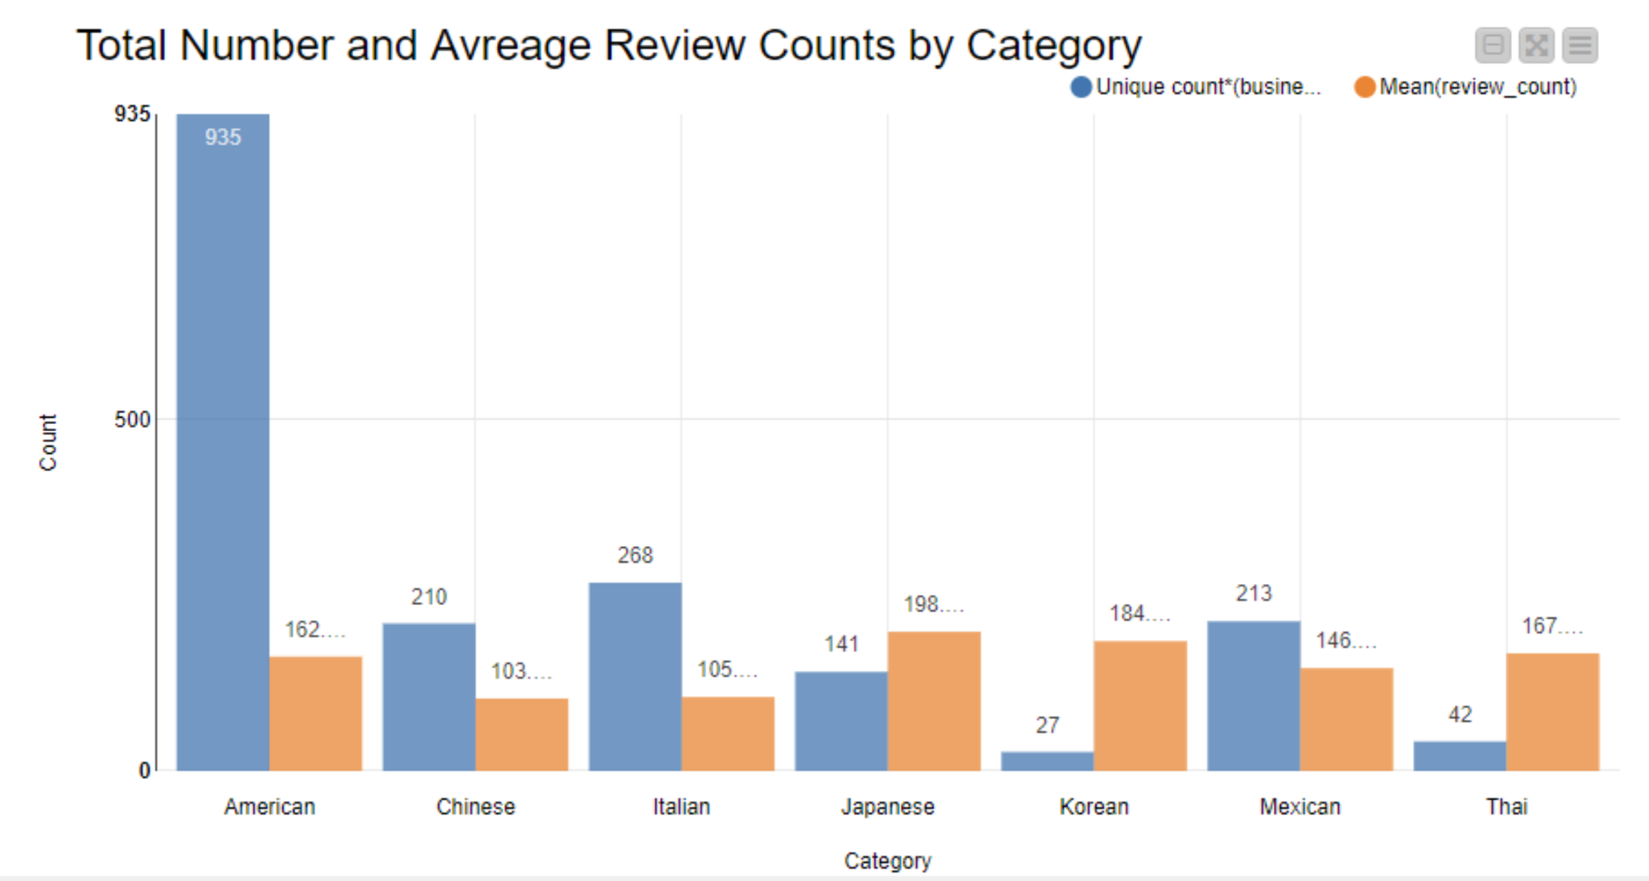
3.1.3 Most popular type (based on average stars and reviews)
Not significant difference in average stars between different category.
Korean and Thai got best average stars.
American restaurants dominant the market.

Slide 27
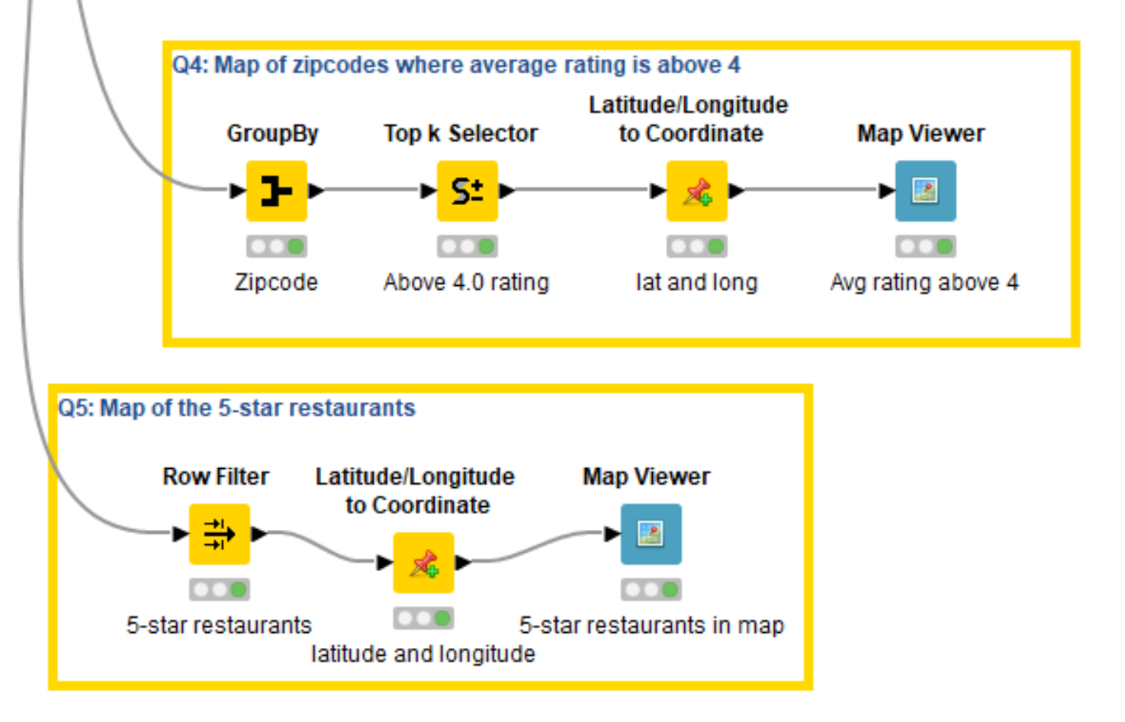
3.1.4 Restaurants zipcodes where average rating is above 4

Slide 28
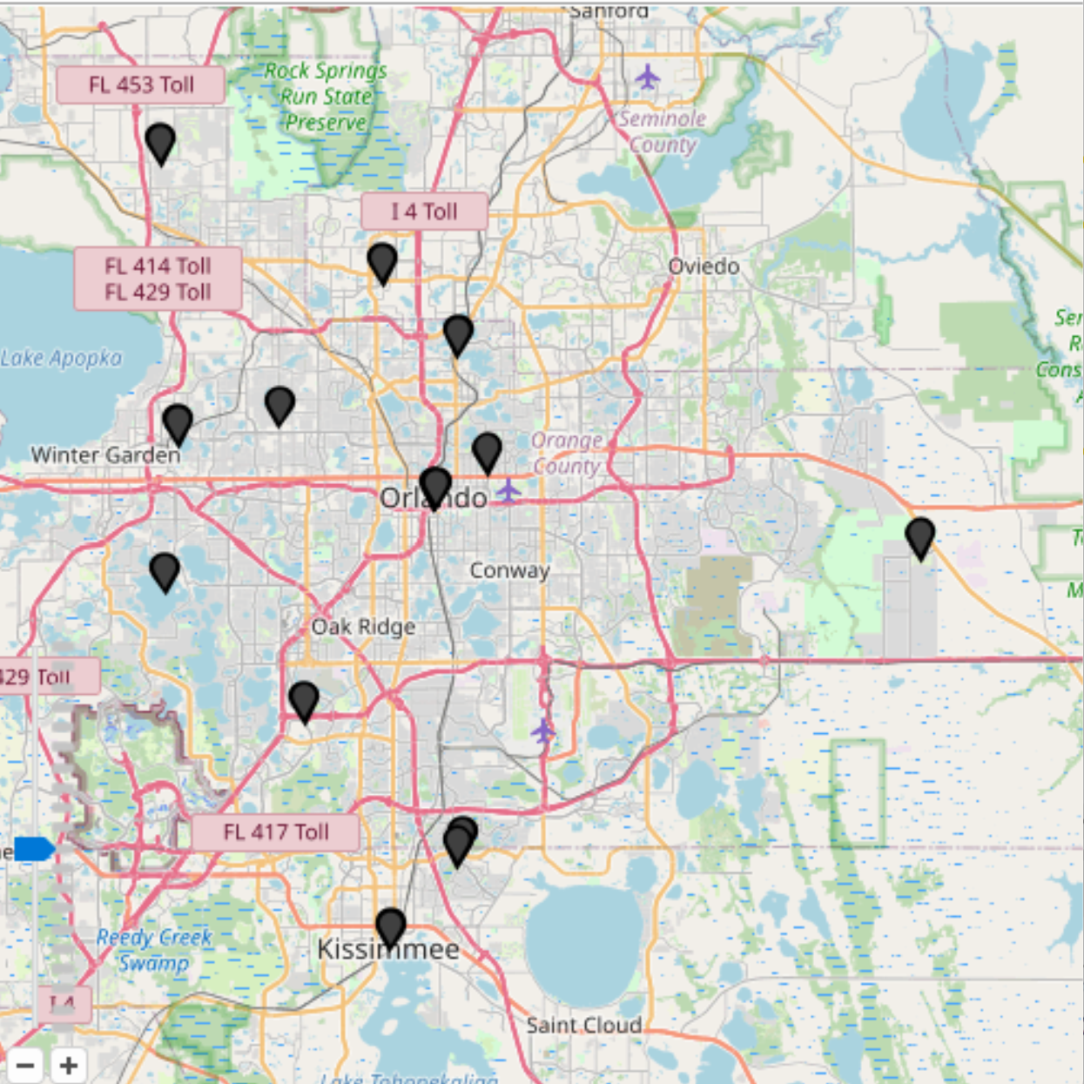
3.1.4 Restaurants zipcodes where average rating is above 4
Universal
Downtown
Sea world

Slide 29
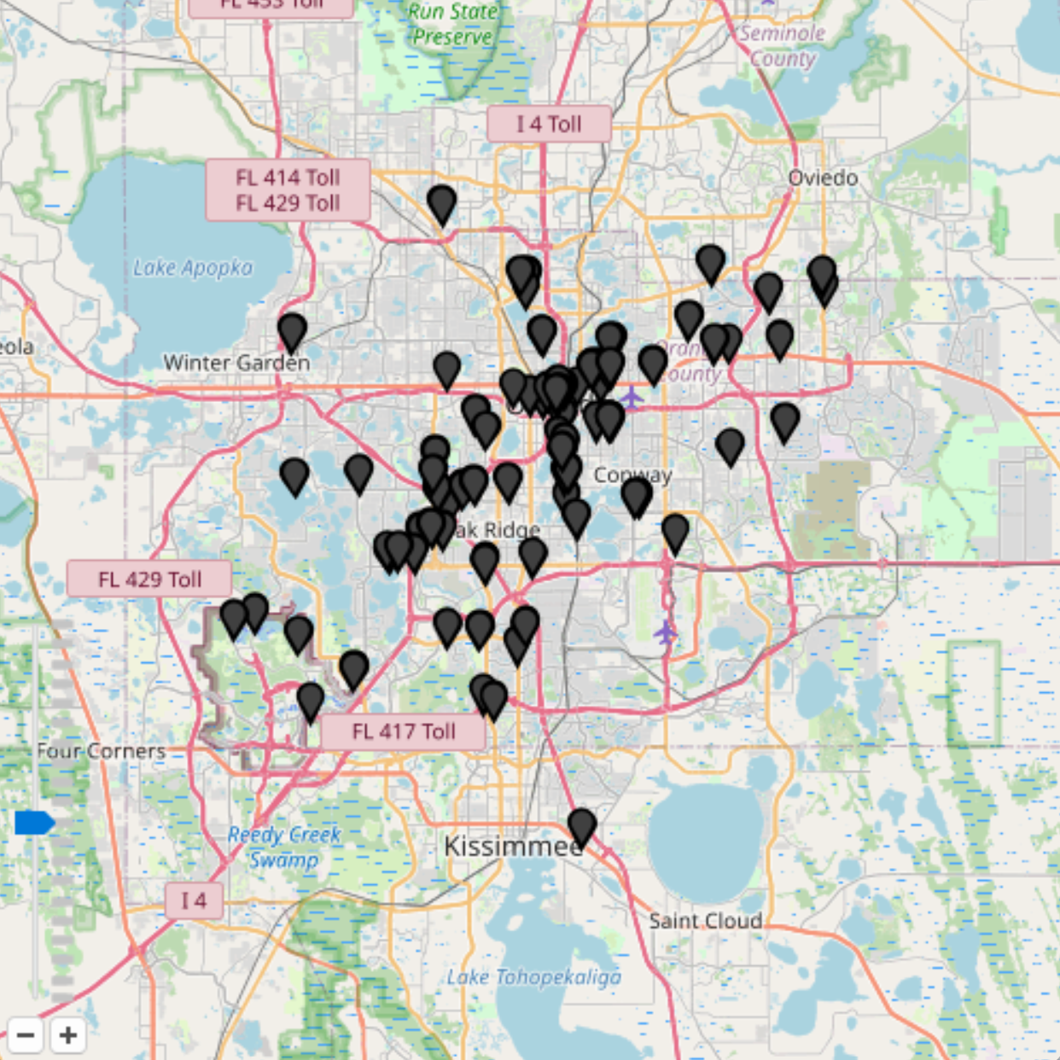
3.1.5 5-star restaurants in map
Universal
Disney
Downtown

Slide 30
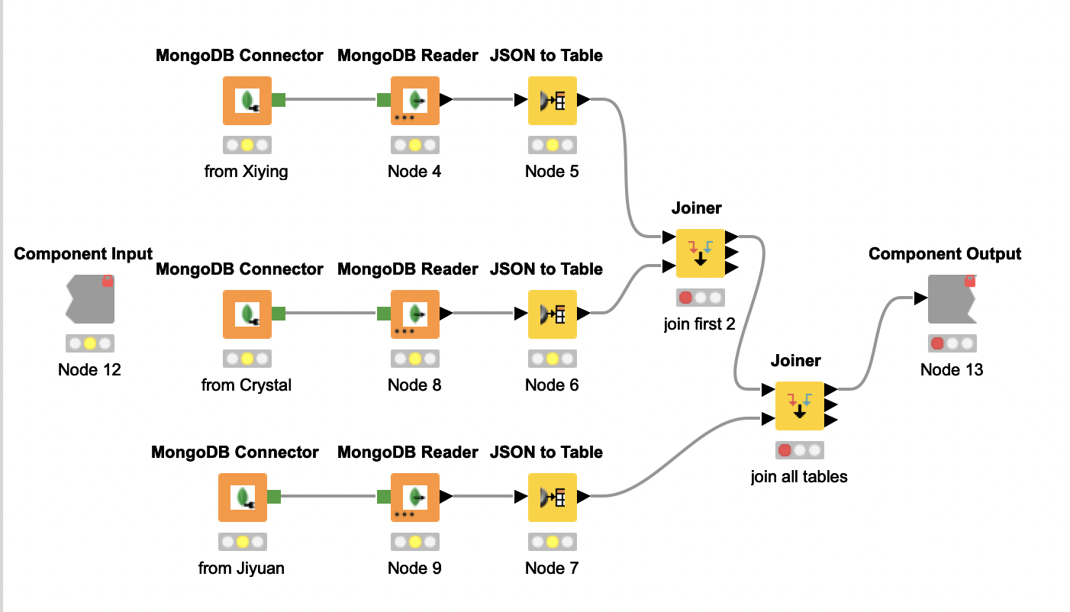
3.2 NFT-Secret Skellies Society
imagine you are a NFT buyer and want to purchase NFT, you want to do some analysis on Secret Skellies Society.
1. Top 10 token by price
2. Token resold times
3. Monthly sales count and volume
4. Daily sellers and buyers
5. Monthly average price of each NFT

Slide 31
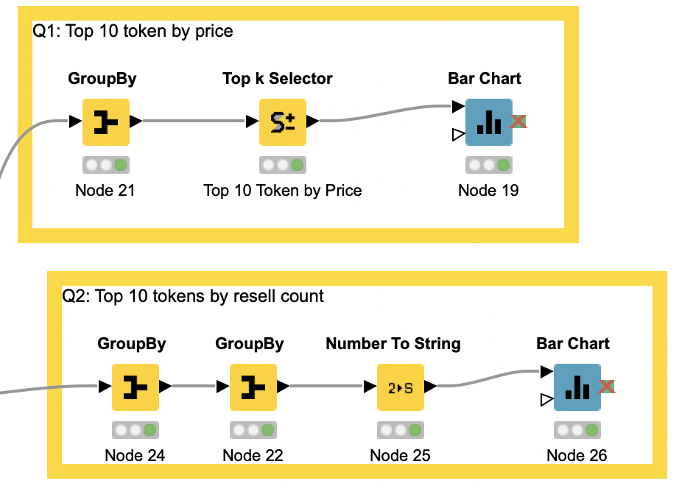
3.2.1 Top 10 token by price

Slide 32
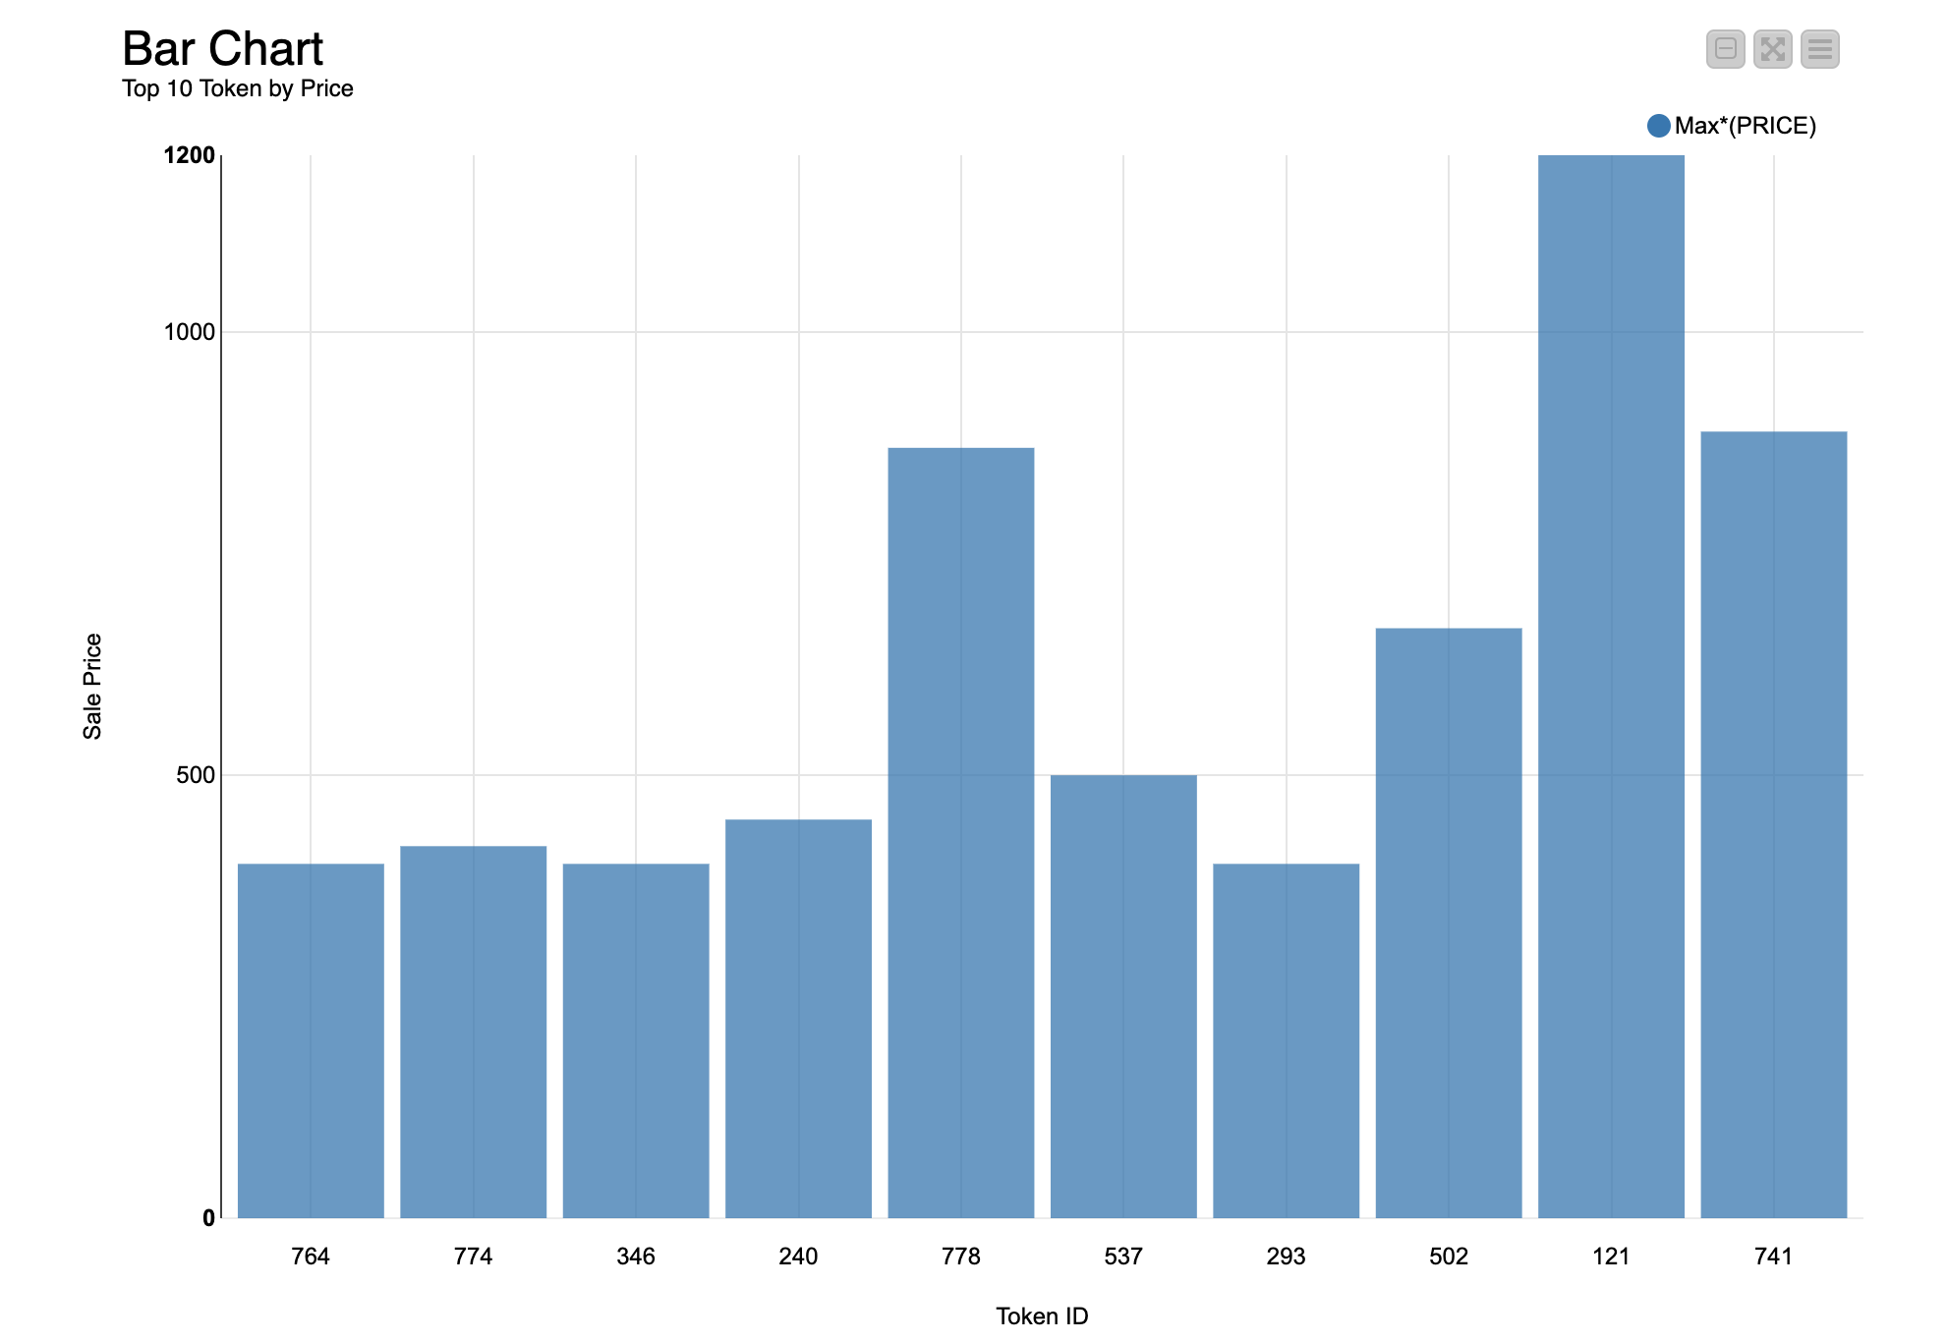

3.2.1 Top 10 token by price
121 was sold for the highest price.

Slide 33
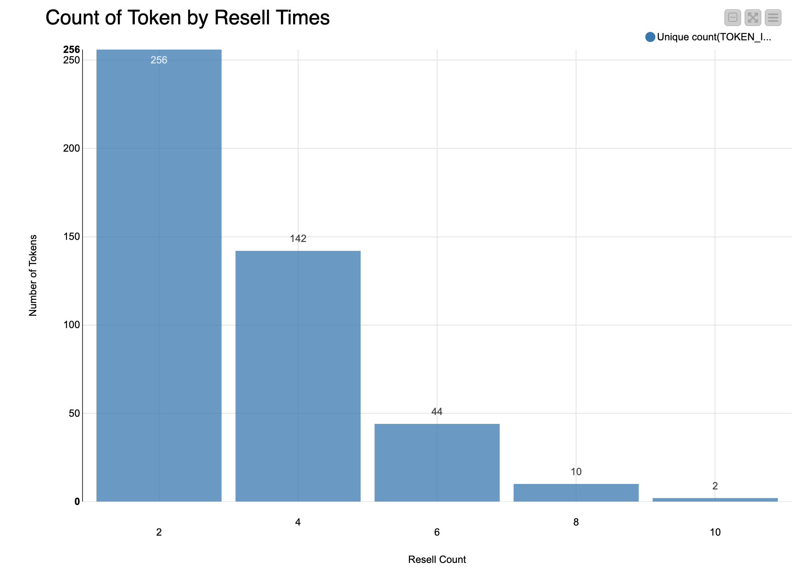
3.2.2 Token resold times
Most tokens are resold for 2 times, only two token are resold for 10 times.

Slide 34
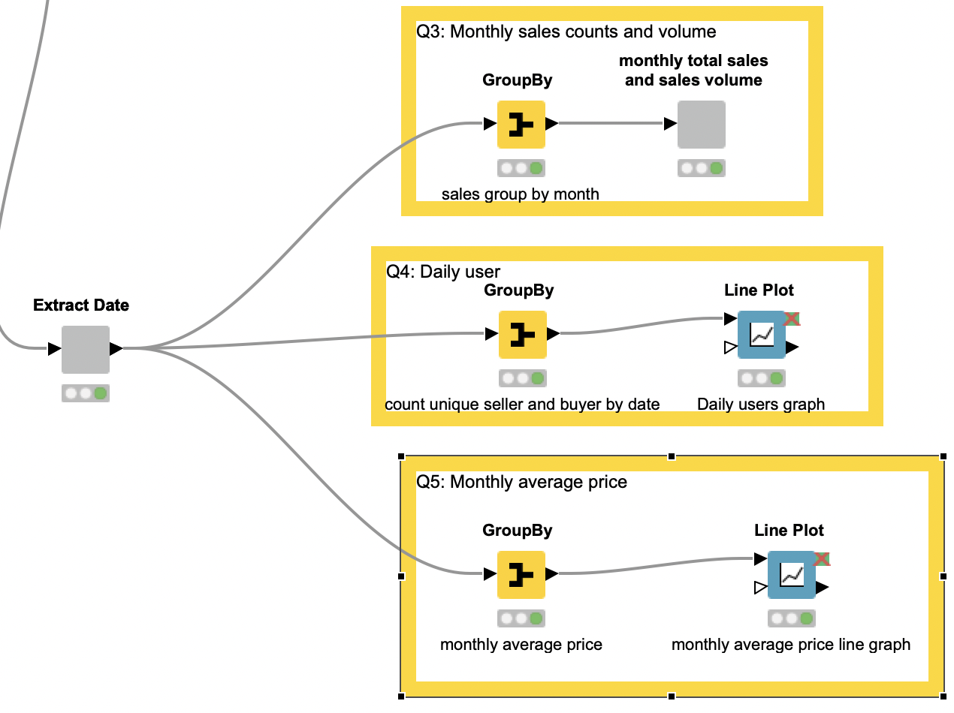
3.2.3 Monthly sales count and volume

Slide 35
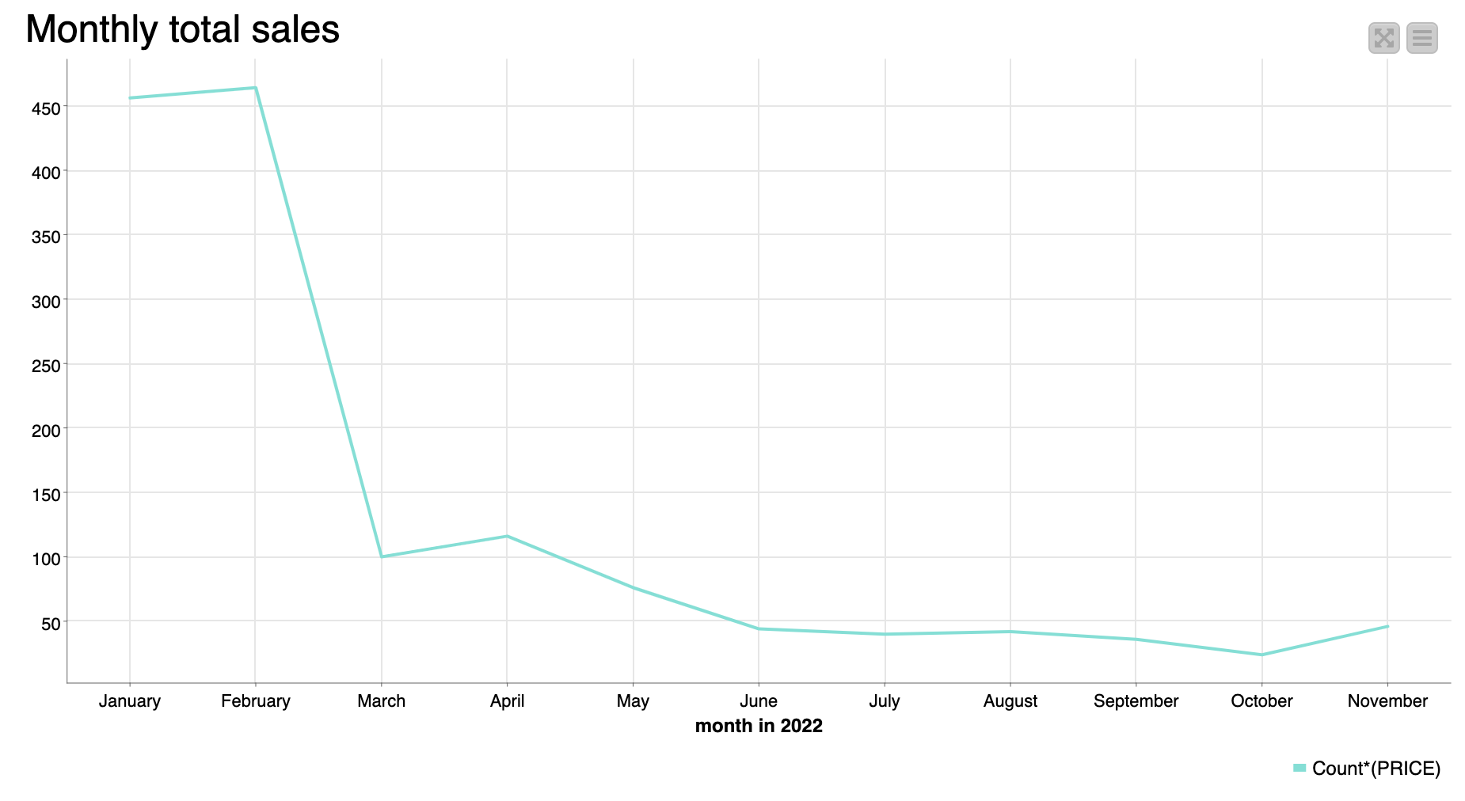
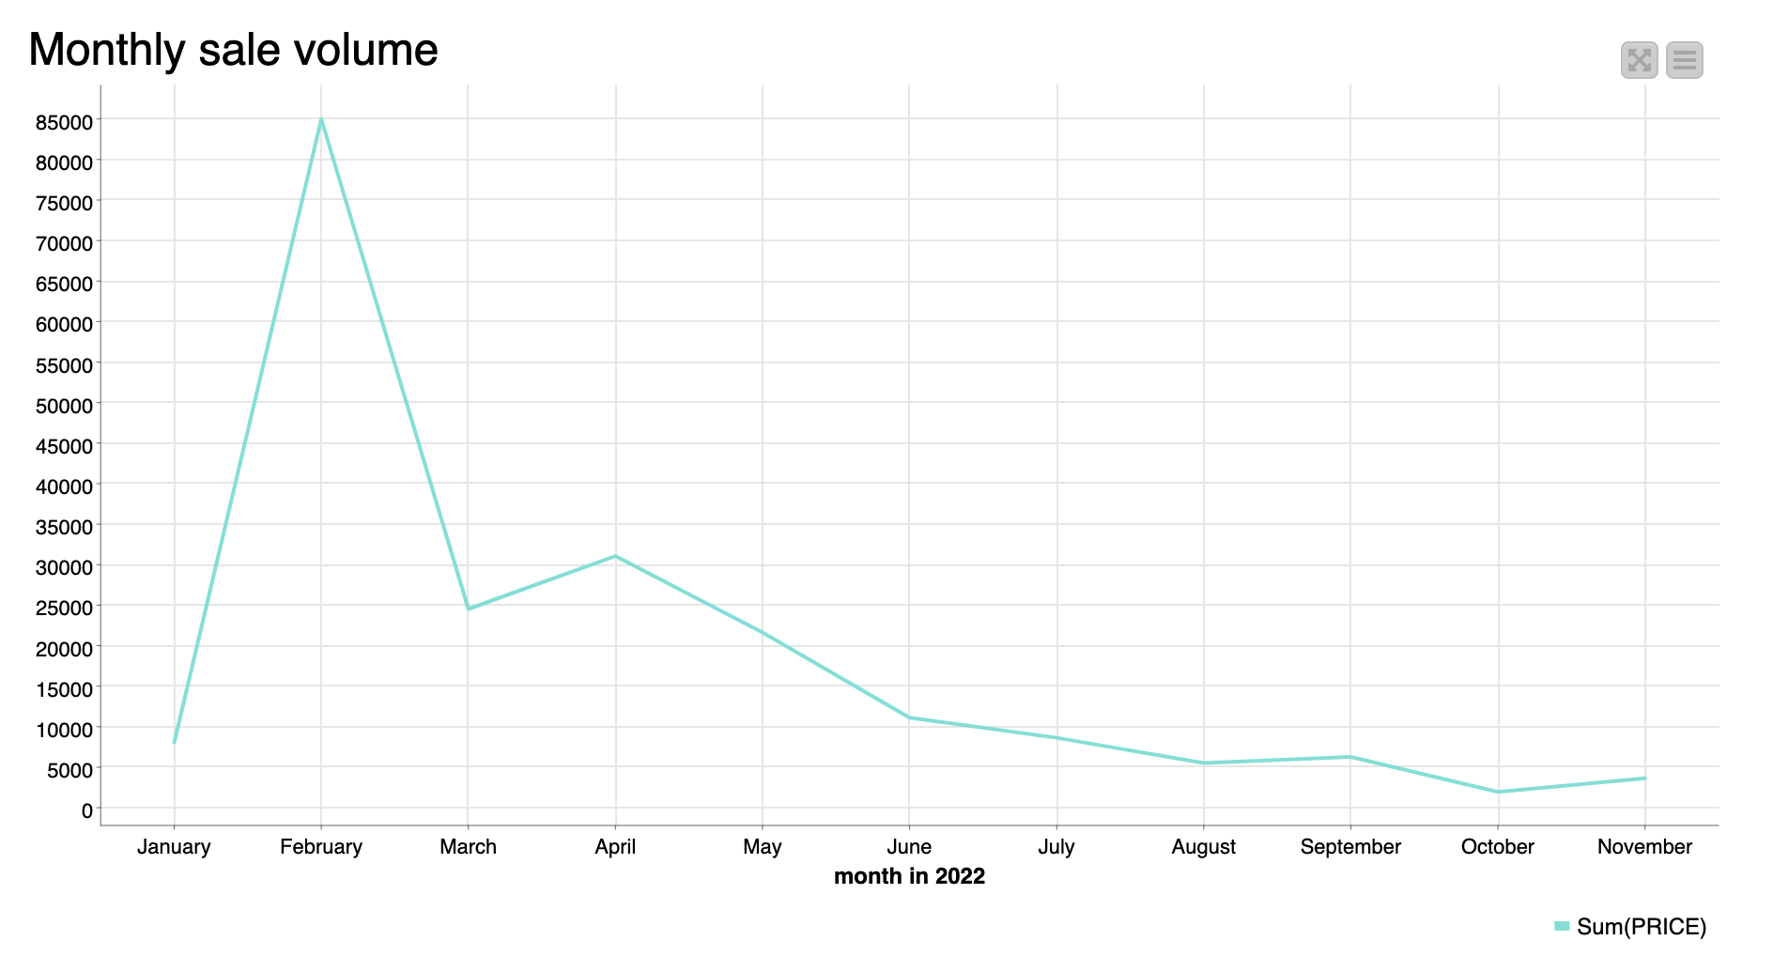
3.2.3 Monthly sales count and volume
In February of 2022, the sales count is relatively high. And it dropped in March.
Although the sales volume in the subsequent period has a small fluctuation, it tends to be flat.

Slide 36
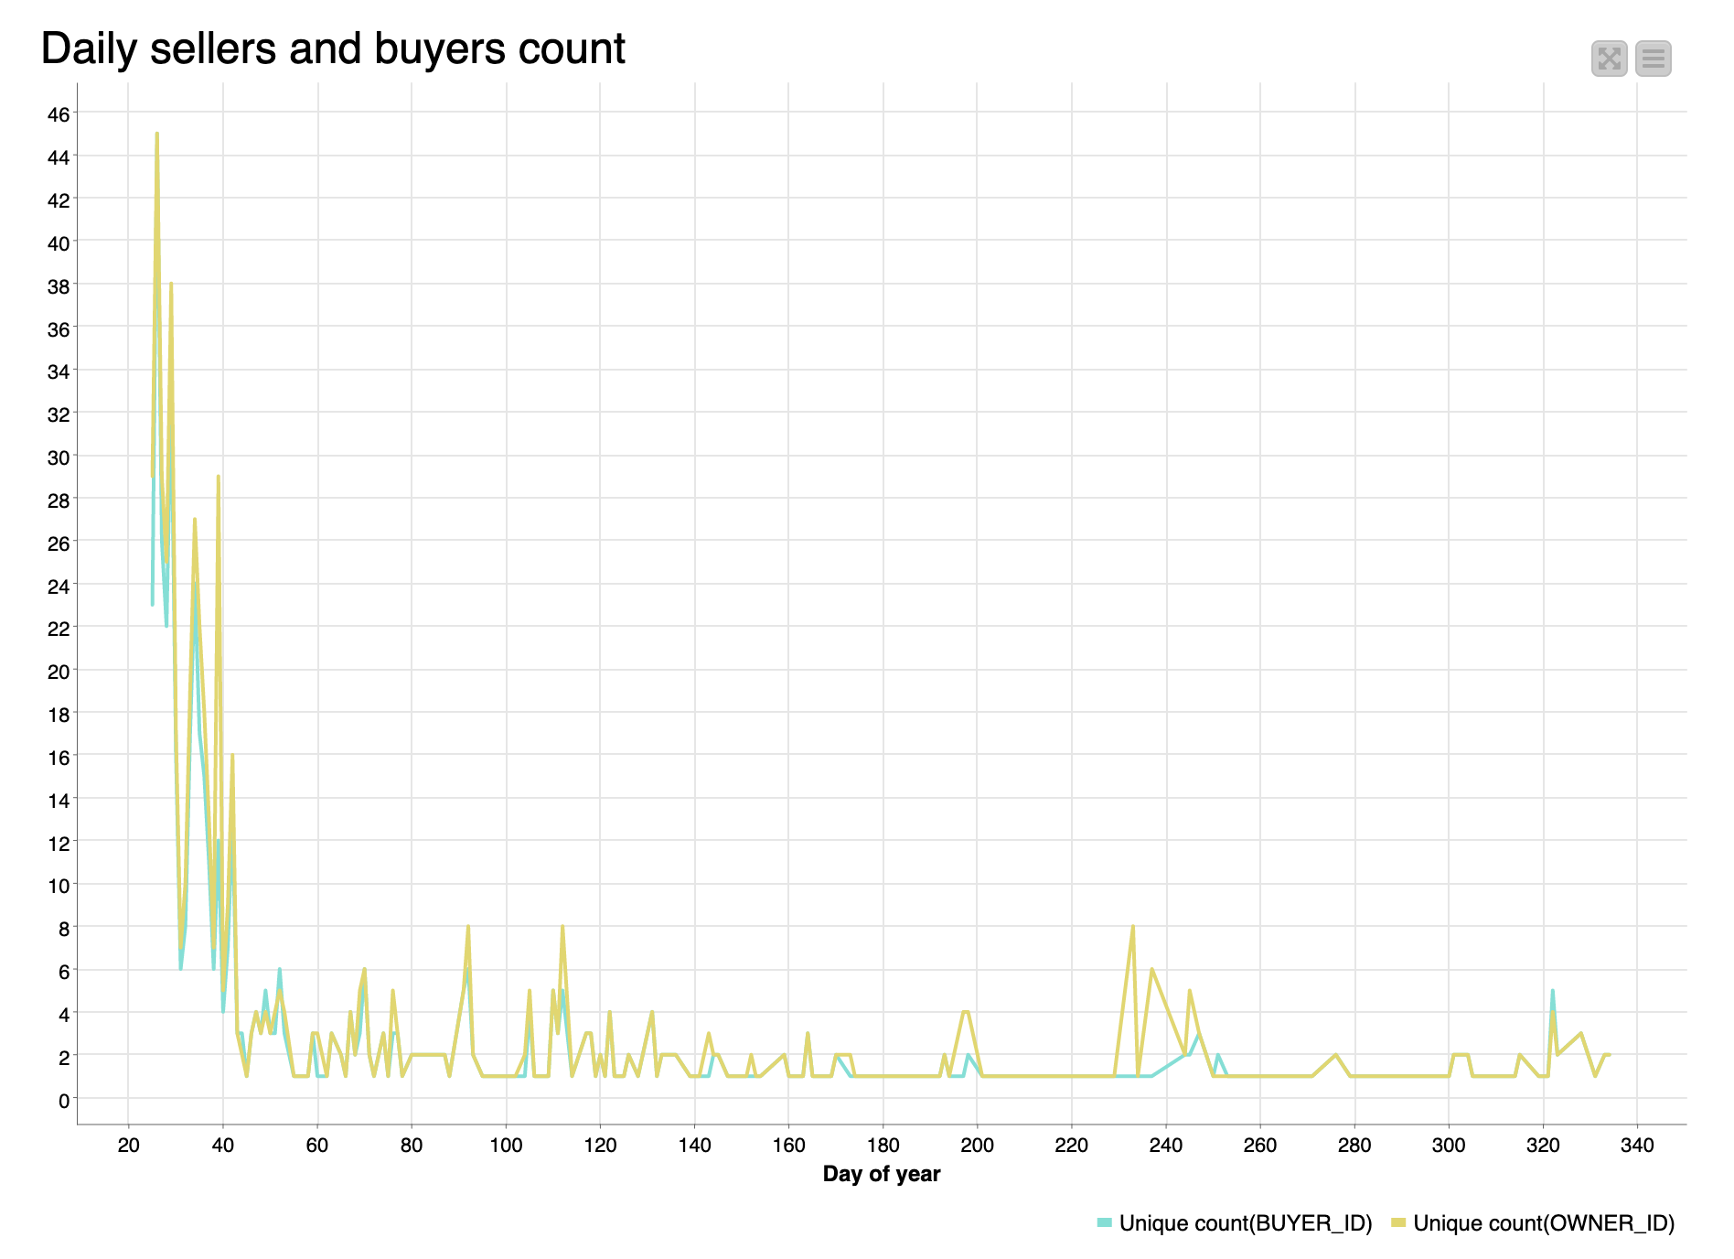
3.2.4 Daily sellers and buyers
The growth trend of new users is basically the same as that of sales.
We can basically infer that these new users have contributed to the sales of the current month.

Slide 37
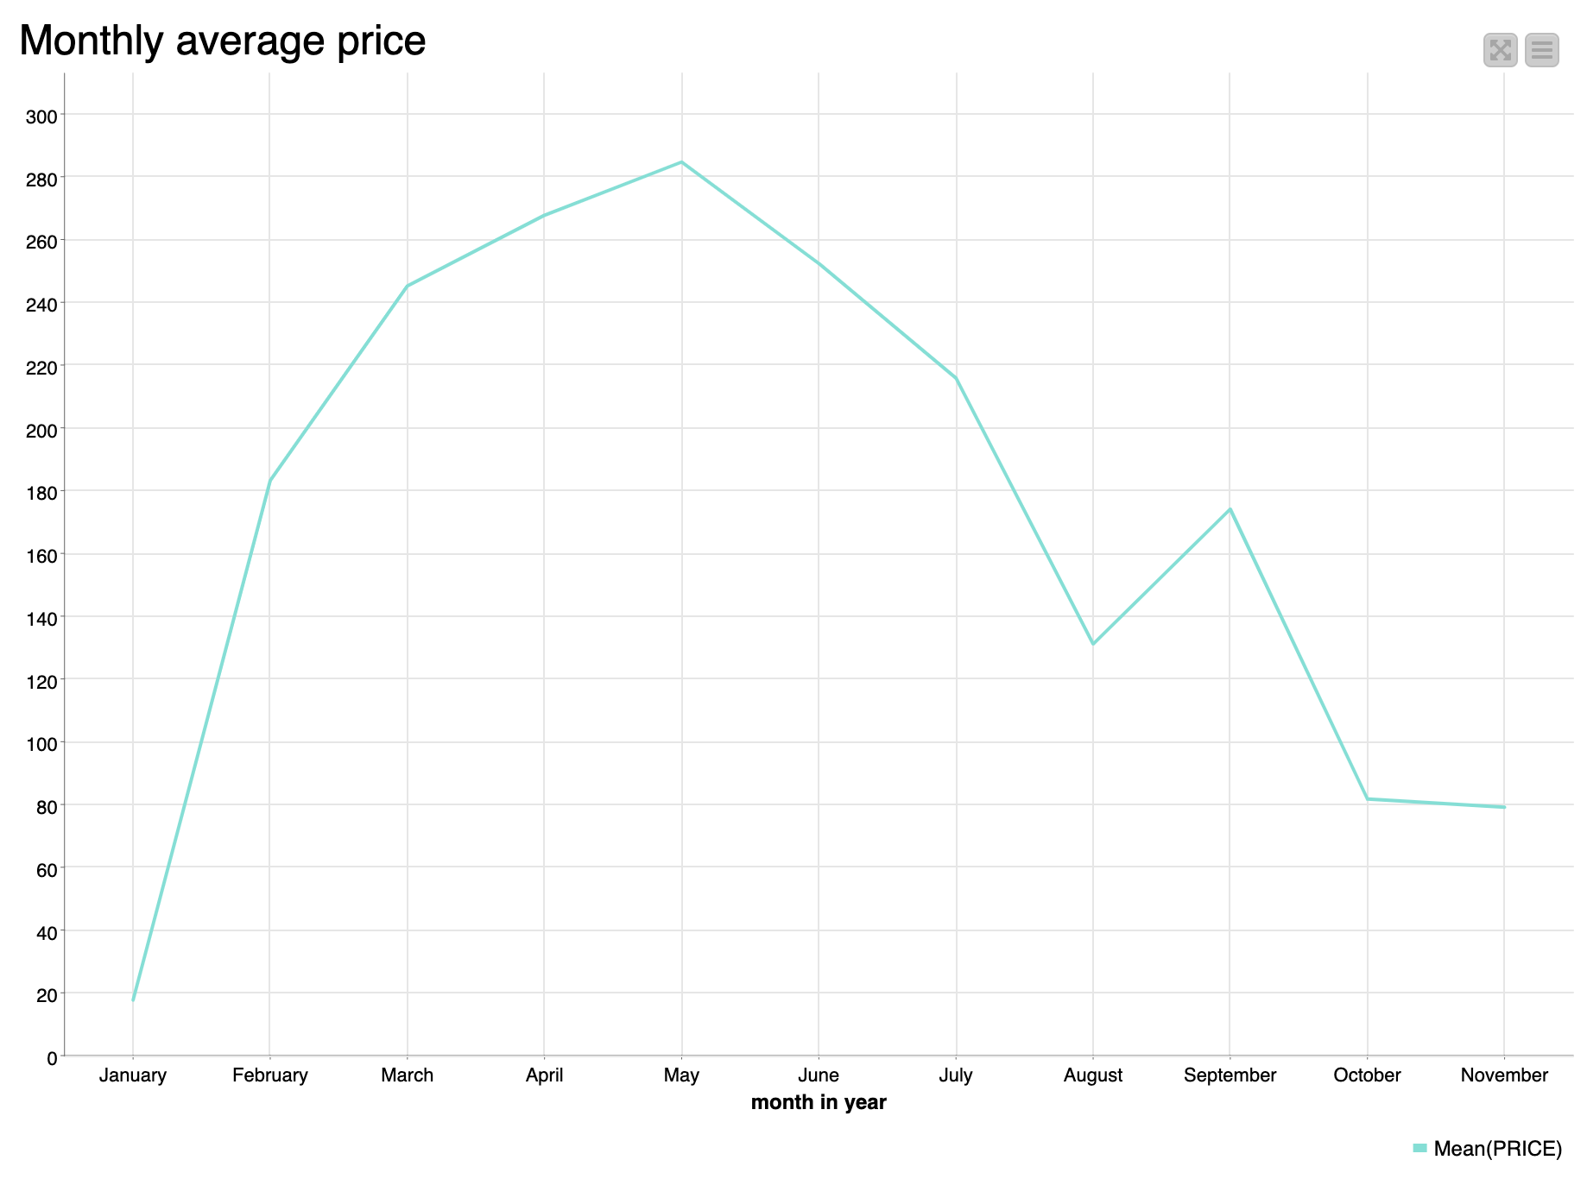
3.2.5 Monthly average price of each NFT
Average price reached a peak in May.

Slide 38
Key skills
· Using Knime to create clear workflows
· Questioning to help solve a business problem

